Slide 1
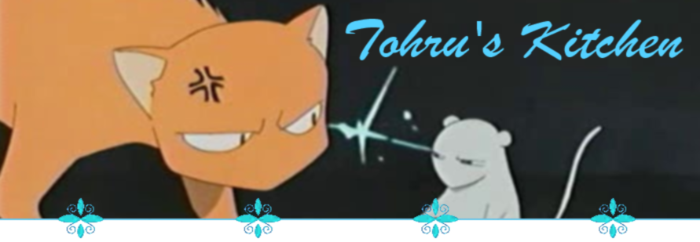
Tohru’s Kitchen
Dana Hagan
Rachael Metcalf
Emily Miller

Slide 2



Tohru’s Kitchen
Cat & Mouse simulation
Simulate natural population factors
Natural evolution

Slide 3
Implementation
ANN: Mice Movement
Inputs: Current location, location of cheese
Outputs: Direction to move
Evolving through breeding
Fitness Function is life score

Slide 4
Current State

Slide 5
Future Plans
Cats
Hunger timer
Breeding Timer
Death
Icon changes during death
Eating disability
Mouse hole
Cat fight
Genders
“Choose your side” – Influencing evolution
Other Fruits Basket members

